Slide 1

PERSONALIZED NUTRITION RECOMMENDATION ENGINE NUTRIFY
22AIE 111 -OBJECT ORIENTED PROGRAMMING IN JAVA
22AIE 112 - DATA STRUCTURES & ALGORITHMS 1
TEAM MEMBERS:
JASWANTH SARAVANAN -CB.SC.U4AIE24324
MAHAKISORE -CB.SC.U4AIE24333
RAVISHANMUGAM -CB.SC.U4AIE24347
SHARVESH SIVAGNANAM -CB.SC.U4AIE24355

Slide 2
INTRODUCTION:
Maintaining a healthy lifestyle is a significant challenge in today’s fast-paced environment, especially for individuals with limited access to varied food options and structured fitness routines.
This project, the Personalized Nutrition Recommendation Engine, aims to address this challenge by integrating customized diet plans with tailored workout routines into a unified platform.
The system is particularly designed for individuals in controlled environments, such as hostels or other institutions, where food accessibility is predefined.

Slide 3
Problem statement:
Problem: Many students struggle to track their daily nutrition and make informed food choices, leading to poor dietary habits.
Solution: Nutrify helps users analyze their BMI, track food intake, and receive optimized meal recommendations based on calorie/protein needs.
Inputs: User profile (age, weight, height, activity level), food items available.
Outputs: BMI calculation, recommended food list, downloadable nutrition report

Slide 4
Abstract:
Nutrify is a Personalized Nutrition Recommendation Engine designed to help users, particularly students, make informed dietary choices. The system leverages Python, SQL, and advanced algorithms to provide meal recommendations based on user-specific parameters such as age, weight, height, and activity level.
Using Trie for fast food search, Knapsack Algorithm for optimized meal selection, and BMI calculations, Nutrify offers a comprehensive approach to tracking nutrition and optimizing food intake.
Users can upload the food items available to them for each day of the week, and Nutrify will generate personalized meal recommendations based on their accessibility and nutritional needs.
The platform features an efficient SQL database, a Flask-based backend, and a user-friendly frontend built with HTML and CSS for seamless interaction. Future enhancements include AI-powered meal recommendations, mobile integration, and food image recognition for an even smarter dietary planning system.

Slide 5
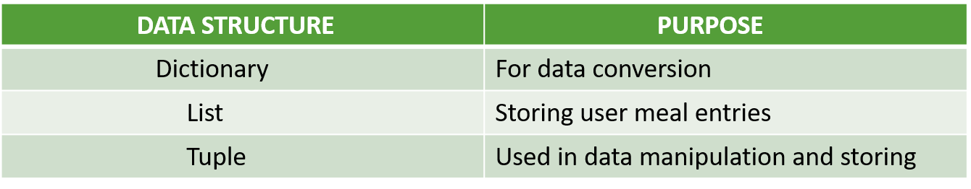
Dsa and oops concept used:
ALGORITHM | TIME COMPLEXITY | SPACE COMPLEXITY
BMI CALCULATION | O(1) | O(1)
JARO WINKLER | O(NM)(N,M – Length of first and second string) | O(N+M)
KNAPSACK | O(NW)(N-No. of samples and W-weight of the sample) | O(NW)
GREEDY | O(NlogN) | O(N)

Slide 6
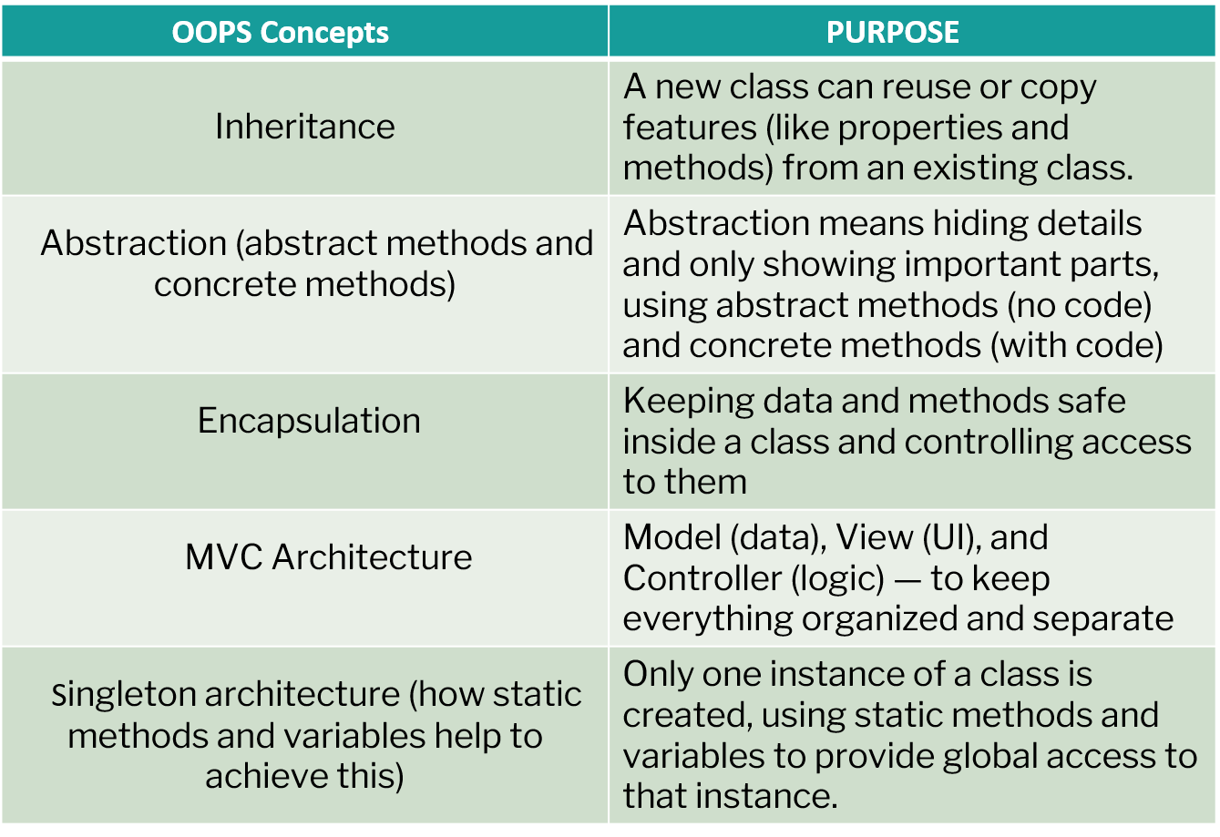
OOPS CONCEPT USED:

Slide 7
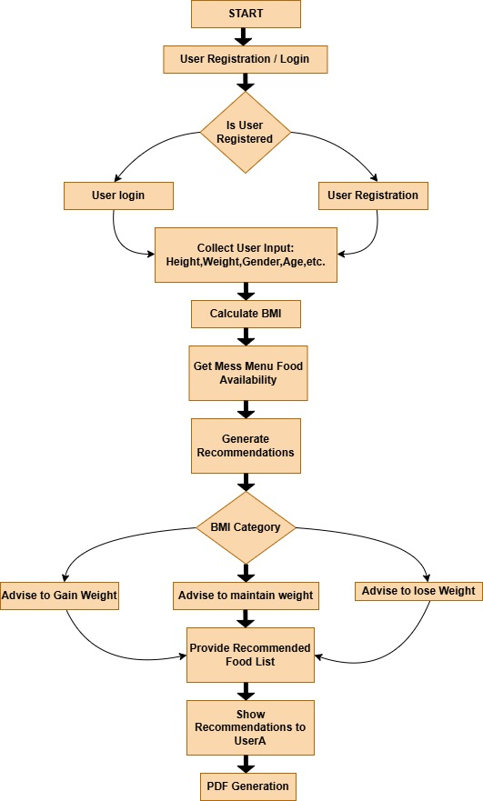

Slide 8
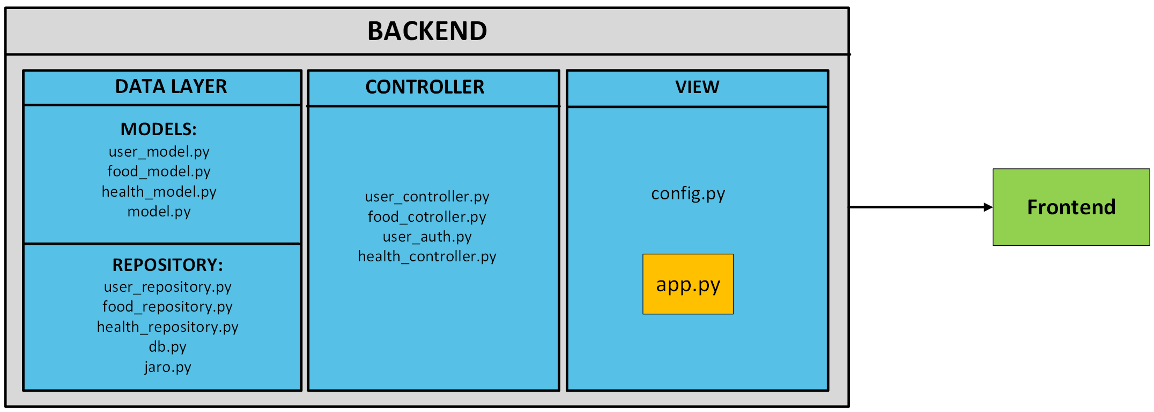
NUTRIFY ARCHITECHTURE:

Slide 9
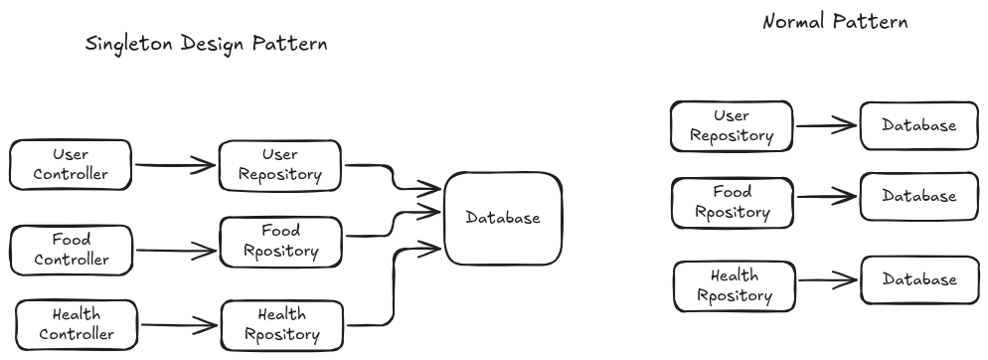
Ensures single source of truth for each model’s data.
Reduces memory usage by avoiding multiple repository instances.
Enables centralized and consistent data access across controllers.

Slide 10
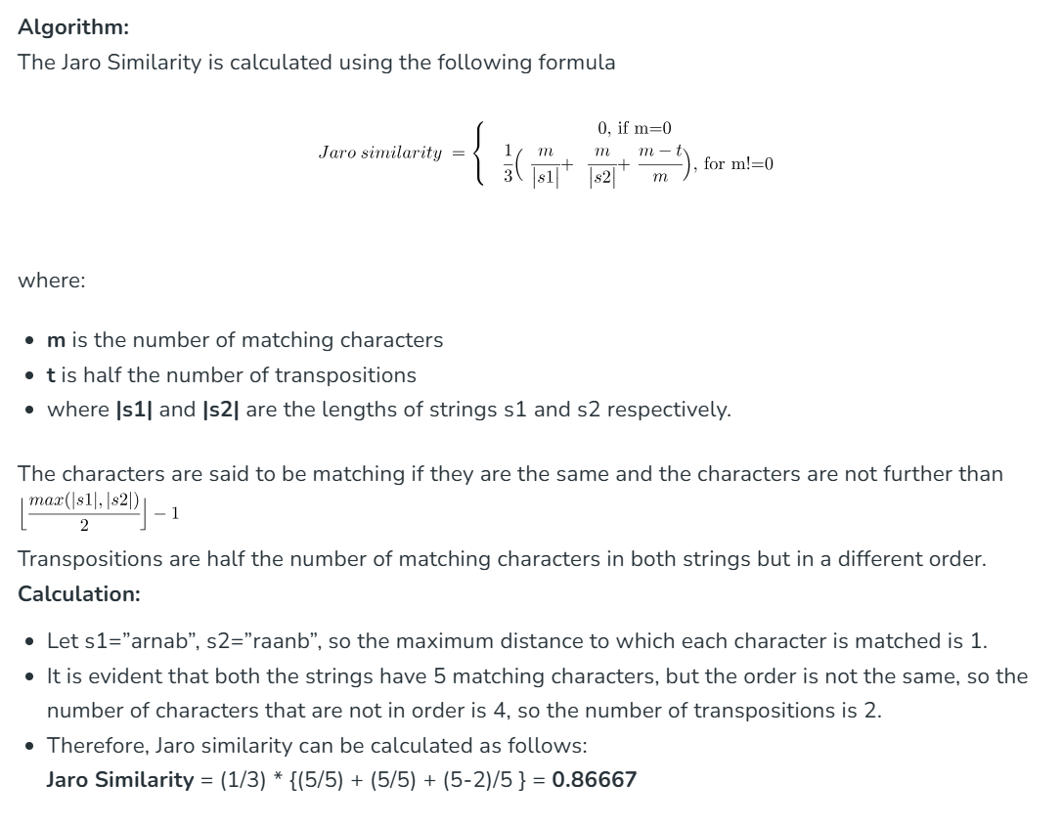
JARO AND JARO WINKLER SIMILARITY OVERVIEW:

Slide 11
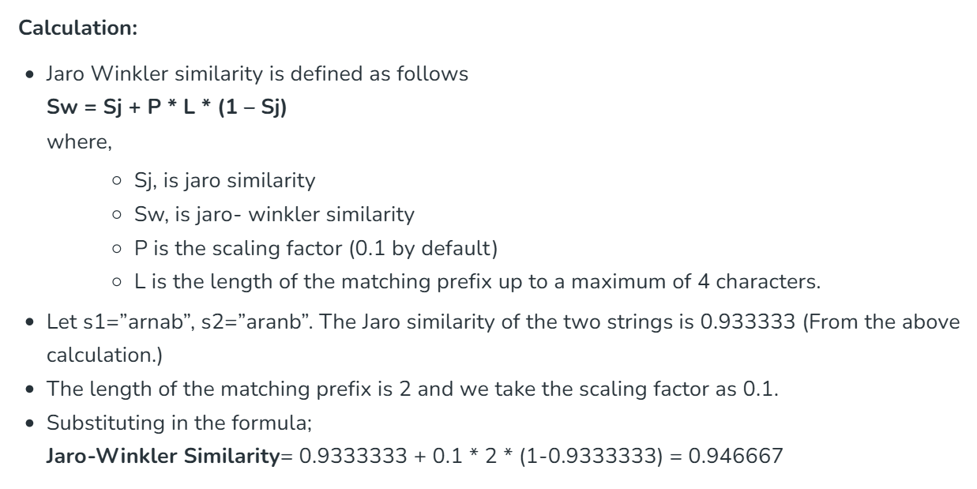
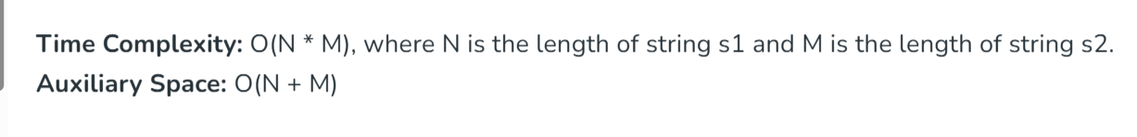
JARO AND JARO WINKLER SIMILARITY OVERVIEW:

Slide 12





TOOLS USED:
HTML
CSS
JAVA SCRIPT
PYTHON FLASK
SQL lite

Slide 13
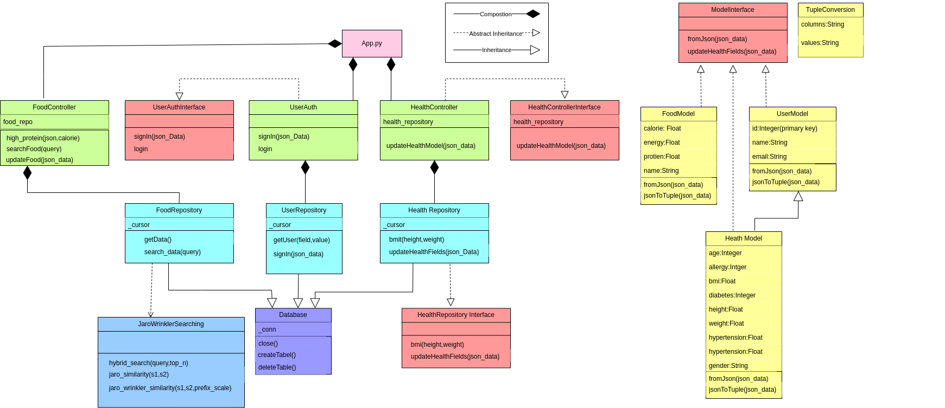
UML DIAGRAM:

